Slide 1
The Cardiovascular
System
HUMAN PHYSIOLOGY
The heart, blood vessels and blood, explained in simple terms with labelled diagrams.
Heart
Valves
Circulation
Blood vessels
Blood
Heartbeat
Disorders
Healthy habits
Notes:
This deck explains how the cardiovascular (circulatory) system works: the heart as a pump, the vessels as pipes, and blood as the transport fluid. It ends with common disorders and ways to keep the heart healthy.

Slide 2
What the cardiovascular system does
OVERVIEW
Heart: the pump
Vessels: the pipes
Blood: the fluid
A muscular organ about the size of a fist. It beats to push blood around the body.
Arteries, veins and capillaries form a network that reaches every cell.
Carries oxygen, nutrients, hormones and wastes, and helps defend the body.
Main jobs
Deliver oxygen and nutrients to cells, remove carbon dioxide and wastes, move hormones and immune cells around, and help control body temperature.
The Cardiovascular System
2
Notes:
The cardiovascular system is also called the circulatory system. Think of a city: the heart is the pumping station, the vessels are the roads and pipes, and the blood is the delivery traffic.

Slide 3
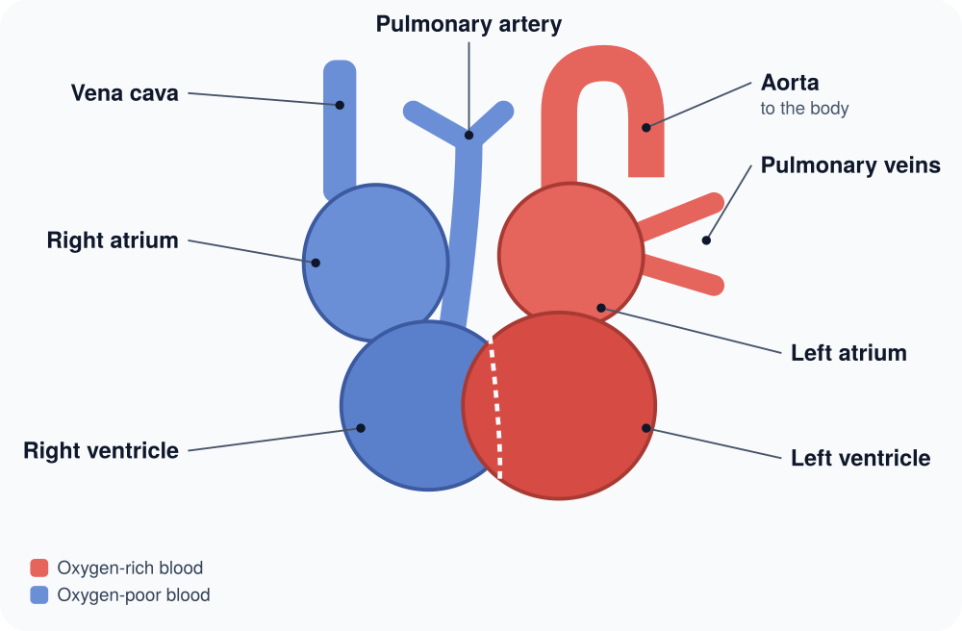
The heart
STRUCTURE
A four-chambered muscular pump with a right side and a left side.
Key parts
Atria – upper chambers that receive blood
Ventricles – lower chambers that pump blood out
Septum – wall between the two sides
In simple terms
The right side sends blood to the lungs; the left side sends it to the body, so its wall is thickest.
The Cardiovascular System
3
Notes:
Blue shows oxygen-poor blood and red shows oxygen-rich blood. In the diagram the heart’s right side appears on the viewer’s left, as if you were facing the person. The heart wall is made of cardiac muscle and is fed by its own coronary arteries.

Slide 4
Heart valves: one-way doors
STRUCTURE
Valve | Sits between | Job
Tricuspid | Right atrium and ventricle | Stops backflow to right atrium
Pulmonary | Right ventricle and pulmonary artery | Lets blood out to the lungs
Mitral | Left atrium and ventricle | Stops backflow to left atrium
Aortic | Left ventricle and aorta | Lets blood out to the body
In simple terms
The “lub-dub” you hear is valves closing: “lub” is the tricuspid and mitral valves, “dub” is the aortic and pulmonary valves.
The Cardiovascular System
4
Notes:
The tricuspid and mitral valves are called atrioventricular (AV) valves; the pulmonary and aortic valves are semilunar valves. A heart murmur can mean a valve does not close fully or is narrowed.

Slide 5
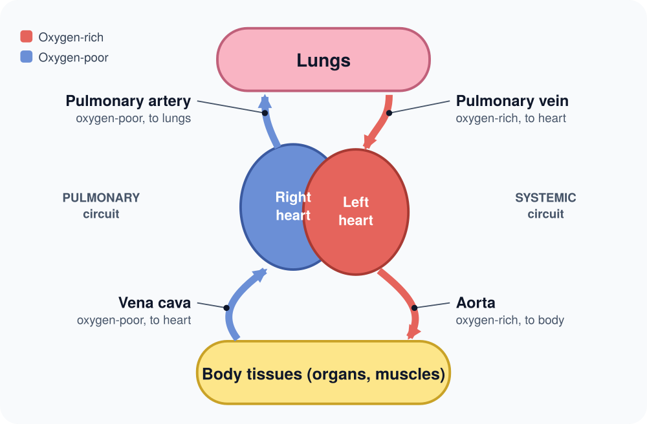
Double circulation
BLOOD FLOW
Blood passes through the heart twice on every full trip around the body.
Key terms
Pulmonary circuit – heart to lungs and back
Systemic circuit – heart to body and back
Vena cava – brings blood back from the body
In simple terms
Right atrium, right ventricle, lungs, left atrium, left ventricle, body, and back again.
The Cardiovascular System
5
Notes:
In the lungs blood picks up oxygen and drops off carbon dioxide. In the body tissues it does the reverse. The pulmonary circuit is short and low pressure; the systemic circuit is long and high pressure, which is why the left ventricle is the strongest chamber.

Slide 6
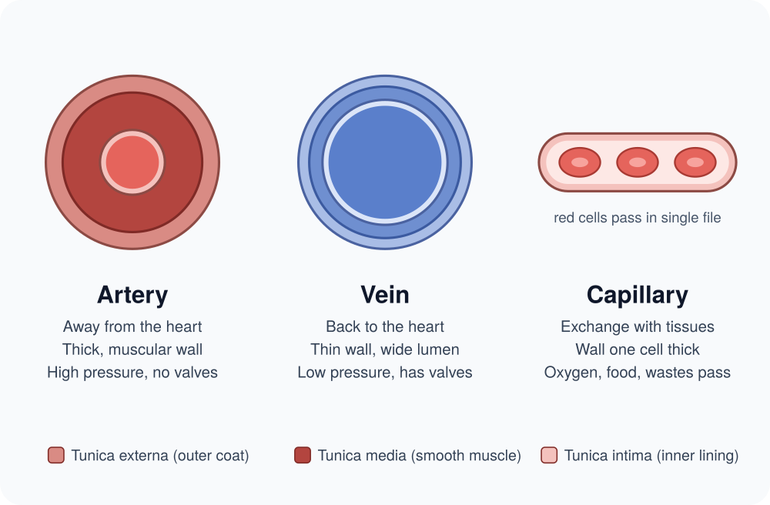
Three vessel types
BLOOD VESSELS
Blood travels in a closed network of tubes, never leaving it.
Key terms
Artery – carries blood away from the heart
Vein – returns blood to the heart
Capillary – tiny tube where exchange happens
In simple terms
Check your pulse: that is an artery stretching each time the heart pushes blood out.
The Cardiovascular System
6
Notes:
Arteries have thick, elastic, muscular walls to handle high pressure. Veins have thinner walls and one-way valves that stop blood falling back, helped by squeezing from nearby muscles. Capillaries are one cell thick so oxygen and nutrients can pass through. Exception to remember: the pulmonary artery carries oxygen-poor blood and the pulmonary veins carry oxygen-rich blood.

Slide 7
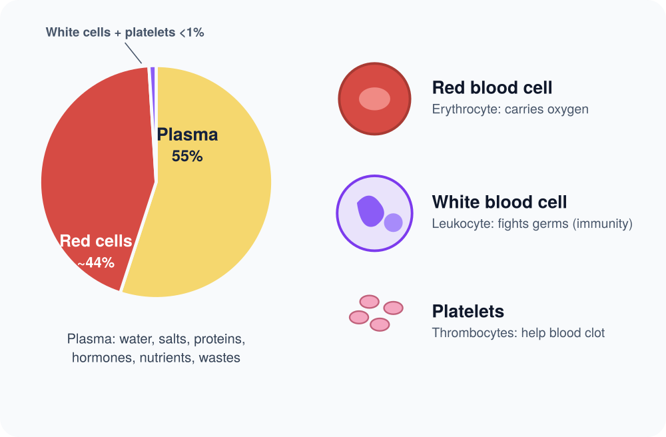
Blood
TRANSPORT FLUID
An adult has about 5 litres: just over half is plasma, the rest is cells.
Key terms
Red blood cells – carry oxygen on haemoglobin
White blood cells – fight infection
Platelets – plug cuts by clotting
In simple terms
A small cut stops bleeding because platelets and clotting proteins form a plug.
The Cardiovascular System
7
Notes:
Plasma is mostly water and carries salts, proteins, hormones, nutrients and wastes. Red cells give blood its colour and have no nucleus, which leaves more room for haemoglobin. Blood cells are made in the red bone marrow.

Slide 8
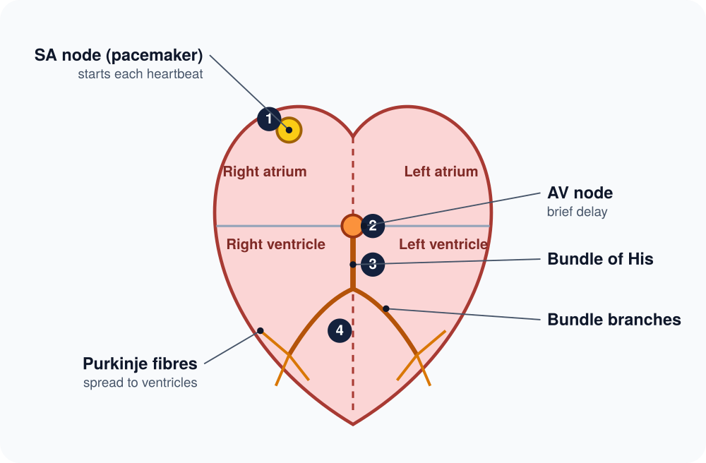
How the heart beats
ELECTRICAL CONTROL
The heart makes its own electrical signal, so it beats without conscious control.
Key terms
SA node – natural pacemaker, starts the signal
AV node – holds the signal for a moment
Purkinje fibres – spread it through the ventricles
In simple terms
The brief pause lets the atria empty into the ventricles before the ventricles squeeze.
The Cardiovascular System
8
Notes:
The numbers show the order: 1 SA node fires and the atria contract, 2 the AV node delays the signal, 3 the bundle of His carries it down the septum, 4 the Purkinje fibres spread it so the ventricles contract from the bottom up. An ECG records this electrical activity. The brain and hormones can speed up or slow down the SA node.

Slide 9
The cardiac cycle
ELECTRICAL CONTROL
One heartbeat alternates squeezing (systole) and relaxing (diastole). At 75 beats a minute, one cycle takes about 0.8 seconds.
Step 1
Step 2
Step 3
Atria squeeze
Ventricles squeeze
Heart relaxes
Atrial systole pushes the last of the blood down into the ventricles.
Ventricular systole sends blood into the aorta and pulmonary artery. The AV valves shut: “lub”.
Diastole lets the chambers refill. The aortic and pulmonary valves shut: “dub”.
The Cardiovascular System
9
Notes:
Systole means contraction and diastole means relaxation. The two numbers in a blood pressure reading match these phases: the top number is pressure during systole and the bottom number is pressure during diastole.

Slide 10
Numbers worth knowing
KEY NUMBERS
60–100
120/80
5 L
5 L/min
Beats per minute
mmHg
Blood volume
Cardiac output
Normal resting heart rate in adults
Healthy blood pressure is below this
Approximate amount in an adult body
Blood the heart pumps at rest
In simple terms
Cardiac output = heart rate × stroke volume (blood per beat, about 70 mL). The top blood pressure number is systolic and the bottom is diastolic.
The Cardiovascular System
10
Notes:
These are typical adult values and they vary between people. For example, 70 beats per minute × 70 mL per beat is about 4.9 litres per minute. Athletes often have a lower resting heart rate because each beat moves more blood.

Slide 11
Common cardiovascular disorders
WHEN THINGS GO WRONG
Condition | What goes wrong
Hypertension | Blood pressure stays too high and strains the heart and vessels
Atherosclerosis | Fatty plaque builds up inside arteries and narrows them
Heart attack | A blocked coronary artery cuts off blood to part of the heart muscle
Heart failure | The heart cannot pump strongly enough to meet the body’s needs
Arrhythmia | The heartbeat is too fast, too slow or irregular
Get urgent help
Chest pain, sudden breathlessness or fainting need emergency medical care.
The Cardiovascular System
11
Notes:
This is general education, not medical advice. Atherosclerosis is the main cause of heart attacks and strokes. Hypertension often has no symptoms, which is why regular blood pressure checks matter. A stroke is a related problem in the vessels of the brain.

Slide 12
Keeping the heart healthy
PREVENTION
Move
Eat well
Avoid tobacco
Aim for at least 150 minutes of moderate activity a week.
More vegetables, fruit and whole grains; less salt and saturated fat.
Smoking damages vessel walls and makes clots more likely.
Healthy weight
Sleep and calm
Get checked
Extra weight makes the heart work harder; limit alcohol too.
Regular sleep and stress management help keep blood pressure down.
Have blood pressure and cholesterol measured regularly.
The Cardiovascular System
12
Notes:
The 150-minute target is the standard adult guidance from the World Health Organization. Small changes add up: walking, taking the stairs and cutting back on salty processed food all help.

Slide 13
Key takeaways
1
The heart is a four-chambered pump: the right side serves the lungs and the left side serves the body.
2
Arteries carry blood away from the heart, veins bring it back, and capillaries swap oxygen, nutrients and wastes.
3
The SA node sets the rhythm and four valves keep blood moving one way.
4
Exercise, good food, no tobacco and regular checks protect the heart for life.
The Cardiovascular System
13
Notes:
Recap the four ideas: structure of the heart, direction of blood flow, the heart’s own electrical control, and prevention.

